Slide 1

360° DASHBOARD
01
02
03
04
PROJECT OVERVIEW
FEATURES AND
FUNCTIONALITIES
SYSTEM ARCHITECTURE
DEMO
Name | Email
Carlos Soeiro | up201706405@fe.up.pt
Francisco Gonçalves | up201704790@fe.up.pt
José Guerra | up201706421@fe.up.pt
Luís Ramos | up201706253@fe.up.pt
Martim Silva | up201705205@fe.up.pt
Group A | Project ID P3

Slide 2
Project Overview
01
Overview
Product
Sales
Financial
Inventory
Procurement
Web App for internal company usage that is able to:
Display critical data grouped by individual dedicated dashboards using comprehensive views
Simplify the analysis of the large stream of data related to the company
Quick access to related business analysis and KPIs

Slide 3
Features and Functionalities
02
Overview
Dashboard KPI's
Sales Summary
Sales Region
Top Products
Balance Sheet
Financial
Vat Paid/Deducted
Profit Margin
Balance Sheet
Revenue and Expenses
Procurement
Types of Suppliers
Suppliers
Supplier Quality Rating
Purchases in Time and Budget
Purchase Order Cycle Time & Lead Time
Sales
COGS
AOV
Profit Margin
Sales Region
Top Products
Inventory
Total Assets in Stock
Average Days to Sell Inventory
Monthly Inventory Turnover
Monthly Average Inventory
Product
Product Information
Top Clients
Units in Stock
Units Sold
Annual Net Profit
Gross Profit vs Net Profit
Yearly Stats

Slide 4




03
System Architecture
03
System Architecture
CoreUI: A complete framework for web frontend development
Bootstrap: HTML, CSS and Javascript framework for UI
ChartJs: HTML based Javascript charts
ReactJS: Front-end Javascript library for UI
Typescript: Strict syntactical superset of Javascript
NodeJS: JavaScript runtime environment
Jasmin: Business management software
Docker: Open source containerization platform
NPM: Packet manager to install dependencies

Slide 5

System Architecture
03
Backend
Web Browser
Jasmin API
Primavera
Tesla 360
Dashboard
ReactJS
Frontend
Web server API
Node.JS
SAF-T
User
Frontend

Slide 6
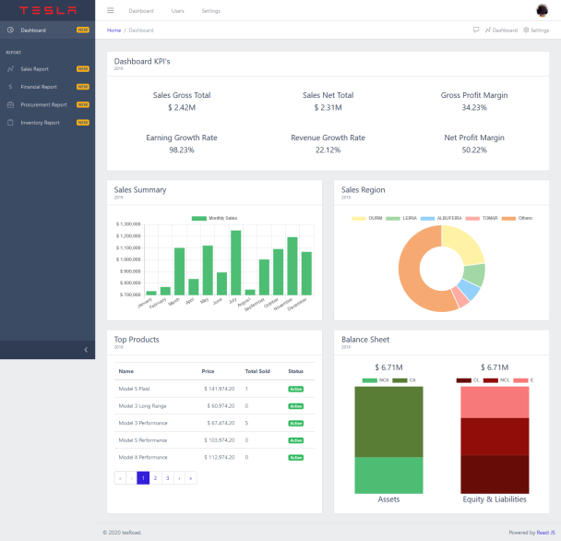
Demo
04

